Slide 1
Dividing Decimals
WALT:
WILF:
Use mental and written methods for dividing decimal numbers
Level 6
Is the answer to:
Is the answer to:
Is the answer to:
Using a mental method work out:
2.4 ÷ 6
Calculate 32.2 ÷ 14
Show your working out
Calculate 32.2 ÷ 0.14
Show your working out
Level 5
Level 5
Level 6
Equivalent calculation Estimate Partitioning
Repeated subtraction Short division Listing factors
Keywords

Slide 2
Dividing Decimals
Starter:
1
6 ÷ 2
2
10 ÷ 5
3
12 ÷ 4
4
15 ÷ 3
5
20 ÷ 5
3
2
3
5
4
6
36 ÷ 6
7
48 ÷ 6
8
40 ÷ 8
9
56 ÷ 8
10
81 ÷ 9
6
8
5
7
9

Slide 3
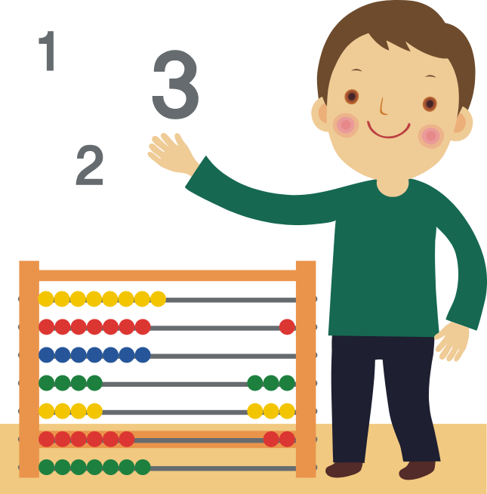
Dividing Decimals
Example of Mental Division:
Calculate: 345 ÷ 3 Partitioning
345 ÷ 3 = (300 ÷ 3) + (45 ÷ 3)
= 100 + 15
= 115
Calculate: 236 ÷ 4 Partitioning
236 ÷ 4 = (200 ÷ 4) + (36 ÷ 4)
= 50 + 9
= 59

Slide 4
Dividing Decimals
Example of Mental Division:
Calculate: 435 ÷ 15 using factors
435 ÷ 15 = 435 ÷ 5 ÷ 3
= 87 ÷ 3
= 29
Calculate: 450 ÷ 13 Partitioning
450 ÷ 13 = (400 ÷ 13) + (50 ÷ 13)
= 30 r 10 + 3 r 11
= 33 r 21
= 34 r 8
Simplify the remainder,
21 ÷ 13 = 1 r 8

Slide 5


Dividing Decimals
Exercise 1:
15 questions to work out in your head. Write the question and answer:
1
45 ÷ 9
2
56 ÷ 7
3
35 ÷ 5
4
560 ÷ 7
5
77 ÷ 7
5
8
7
80
11
6
115 ÷ 5
7
65 ÷ 5
8
448 ÷ 4
9
333 ÷ 3
10
180 ÷ 15
23
13
112
111
12
11
162 ÷ 18
12
276 ÷ 12
13
550 ÷ 13
14
410 ÷ 19
15
330 ÷ 21
9
23
42 r 4
21 r 11
15 r 15
Remainders
Jane gets paid £504 per week. Her hourly rate is £14 per hour. How many hours does she work per week?
36 hours
John buys 65 pens for 28p each and sells them all in his school shop. He sells them all for £17.55. Did he make a profit?
27p each
No

Slide 6
Dividing Decimals
Examples:
Give your answer to 1 decimal place.
Work out 45.6 ÷ 6
Work out 88.3 ÷ 15
Work out 532 ÷ 3.9

Slide 7
Dividing Decimals
Exercise 2:
Work out the following, give your answers to 1 decimal place:
1
4.5 ÷ 9
2
13.8 ÷ 6
3
3.15 ÷ 5
4
39.2 ÷ 7
5
38.4 ÷ 8
0.5
2.3
0.63
5.6
4.8
6
36.9÷3
7
81.9÷13
8
73.5÷15
9
66.6÷18
10
30.6÷17
12.3
6.3
4.9
3.7
1.8
11
465÷1.2
12
310÷1.3
13
525÷2.5
14
296÷2.2
15
312÷1.4
387.5
238.5
210
134.5
222.9
Claire gets paid £285 per week. She works 30 hours a week. How much does she get paid per hour?
£9.50
Mark’s car travels 321 miles on 30 litres of fuel. Kate’s car travels 378 miles on 36 litres of fuel. Which car travels further for each litre of petrol?
Mark: 10.7L
Kate: 10.5L
Mark’s car is best

Slide 8
Dividing Decimals
Plenary:
Work out these questions
1
63.2 ÷ 8
2
99 ÷ 15
7.9
6.6

Slide 9
Dividing Decimals
WALT:
WILF:
Use mental and written methods for dividing decimal numbers
Level 6
Is the answer to:
Is the answer to:
Is the answer to:
Using a mental method work out:
2.4 ÷ 6
Calculate 32.2 ÷ 14
Show your working out
Calculate 32.2 ÷ 0.14
Show your working out
Level 5
Level 5
Level 6
Equivalent calculation Estimate Partitioning
Repeated subtraction Short division Listing factors
Keywords

Slide 10
Homework: Dividing Decimals
Work out the following using mental methods:
1
4.5 ÷ 9
2
13.8 ÷ 6
3
3.15 ÷ 5
0.5
2.3
0.63
Work out the following, give your answers to 1 dp (SHOW WORKING):
1
273 ÷ 13
2
25.6 ÷ 4
3
350 ÷ 1.2
21
6.4
291. 7
Andy gets paid £238 per week. She works 28 hours a week. How much does she get paid per hour?
£8.50

